Slide 1
Children’s Mental Health Screener

Slide 2
Table of Contents
What is the CMH Screener?
Why use the CMH Screener?
When would the CMH Screener be used?
What is in the CMH Reference Guide?
How to Administer the CMH Screener
Identifying Needs
Level of Need
Rating of Core items
Understanding Level of Need and Rating
Questions to Consider
Ratings Calculation
Action Steps
Using the Online CMH Screener
For More Information

Slide 3
WHAT IS THE CMH SCREENER?
It is a tool used to support the transformation of children’s mental health (CMH) services in Idaho. As part of the new System of Care for children’s mental health, the screener plays an important role in Idaho’s Youth Empowerment Services (YES).
The CMH Screener is based on the Idaho CMH CANS (Idaho’s version of the Child and Adolescent Needs and Strengths).
The CANS is not a diagnostic tool. Instead, it allows for the effective communication of a shared vision.
The CMH Screener is designed to help providers identify unmet mental health needs, and to link families to further assessment and treatment. It should be used when a practitioner suspects mental health concerns.
It is available in a printable paper version and an online version at www.IdahoCMHScreener.com

Slide 4
WHY USE THE CMH SCREENER?
The CMH Screener was specifically designed for practitioners in a non-mental health setting.
The CMH Screening tool is much shorter than the CMH CANS, and can be completed anywhere.
Certification for the screener is NOT required
It is easy to learn and has an excellent national, and international reputation among providers and other partners in the services system because it is easy to understand and act upon.
Early identification of mental health needs, when treated, leads to better outcomes.

Slide 5
What is the CMH Reference Guide?
CMH Screener Reference Guide
The CMH Screening Form Reference Guide contains symptom and ratings descriptions for each CMH Screener item. It also contains helpful “questions to consider” to assist when rating an item.
Use the Reference Guide in conjunction with the CMH Screener form.

Slide 6
How to administer the CMH SCreener
Review the CANS Screener Reference Guide.
Understand how the needs items are rated.
Ask open-ended questions to fill in information.
Discuss the ratings and outcome with the child and/or family
Work together with the child/youth, family and other stakeholders to build consensus regarding the given rating.
Consider any existing information that may have been collected.
Complete the CANS Screener form with the child / family and stakeholders

Slide 7
IDENTIFYING NEEDS
The CMH Screener is divided into Domains:
Behavioral/Emotional Needs
Life Functioning Domain
Risk Behavior Domain
Caregiver Resources and Needs.
Each domain is then divided into Core Items, such as Anxiety, Family and Anger Control.
Each of these core items, is given a rating from 0-3, based on the level of need of the defined Core Item in the CMH Screener Reference Guide.
The CMH Screener is given a final total rating. This total rating will inform providers and the family regarding the need to pursue mental health treatment options.

Slide 8
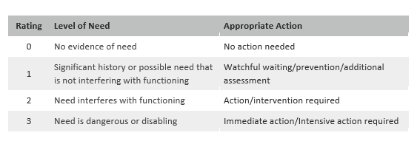
LEVEL OF NEED
The level of need is determined in conjunction with the appropriate action level.
Example: Is the need interfering with functioning? If YES, this would mean the need requires a therapeutic action or intervention (Action/intervention required). A rating of 2 would be given.
Example: If a need is identified, but it is not interfering with level of functioning, the need should be monitored (Watchful waiting/prevention/additional assessment). A rating of 1 would be given.
Example: Is the need dangerous or disabling? If YES, this would mean the need requires immediate action or intervention. Arating of 3 would be given.

Slide 9
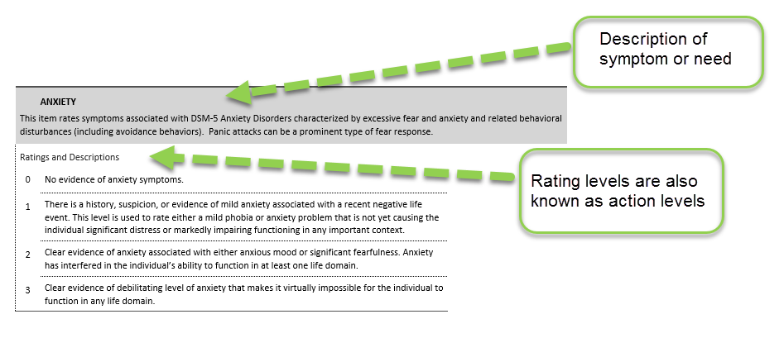
RATING CORE ITEMS

Slide 10
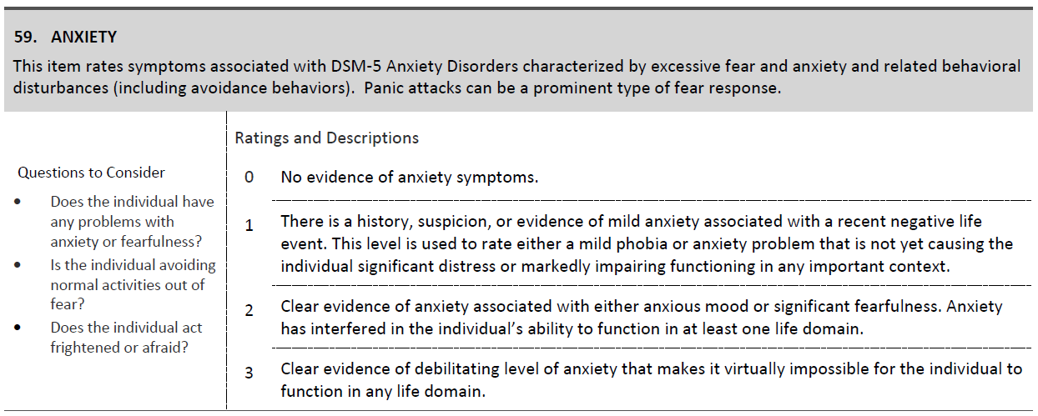
Understanding level of need and rating
{
{

Slide 11
Questions to consider
Each core item contains” Questions to Consider” in the CMH Screener Reference Guide. These questions can assist in determining the level of rating.
Example:
Anxiety: Questions to consider
Does the individual have any problems with anxiety or fearfulness?
Is the individual avoiding normal activities out of fear?.
Does the individual act frightened or afraid?

Slide 12
RATINGS CALCULATION
If you completed the paper copy of the CMH Screener you will need to manually calculate the total rating by using the guidelines on the following slides.
The online CMH Screener automatically calculates the rating for you.

Slide 13
RATINGS CALCULATION
A. Did you rate the child/youth “YES” in Behavioral/Emotional Needs? (YES: A rating of ‘2’ or greater or two ratings of ‘1’ or greater in the domain?)
Example: youth was rated as a ‘2’ in Mood Disturbance=YES
Youth is rated as ‘1’ in Anger Control and ‘2’ in Mood Disturbance=YES
Youth is rated as ‘0’ in all areas of Behavioral/Emotional=NO
IF “YES,” continue to question B.
B. If “YES” to question A, did you rate the youth/child as “YES” in Life Functioning or Risk Behaviors or Caregiver Resources? (YES: A rating of 1 or greater on any question in the domain).
Example: youth is rated as ‘2’ in family=YES

Slide 14
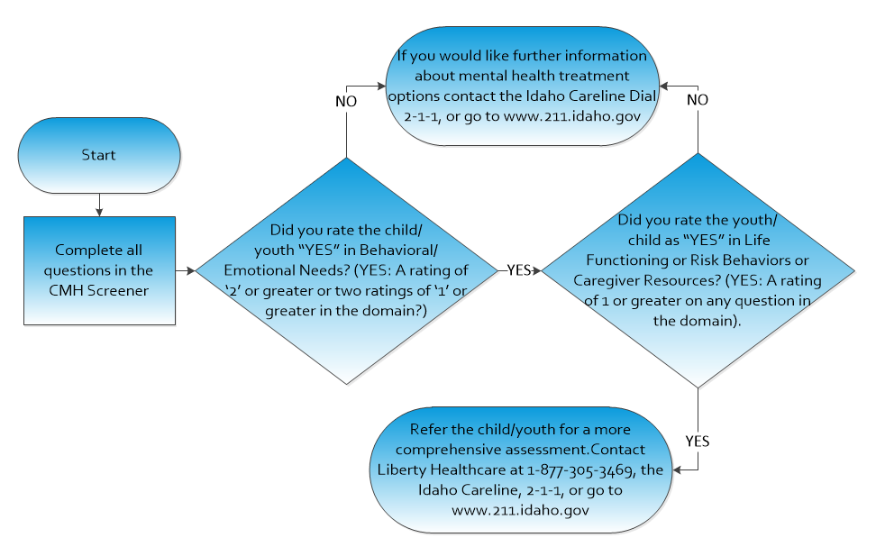
RATINGS CALCULATION

Slide 15
ACTION STEPS
If “YES” to both A and B:
If “No” to either A and/or B:
Refer the child/youth for a more comprehensive assessment:
Contact Liberty Healthcare at 1-877-305-3469, the Idaho Careline, 2-1-1, or go to www.211.idaho.gov
Still have concerns? Further information about mental health treatment options is available at the Idaho Careline. Dial 2-1-1, or go to www.211.idaho.gov

Slide 16
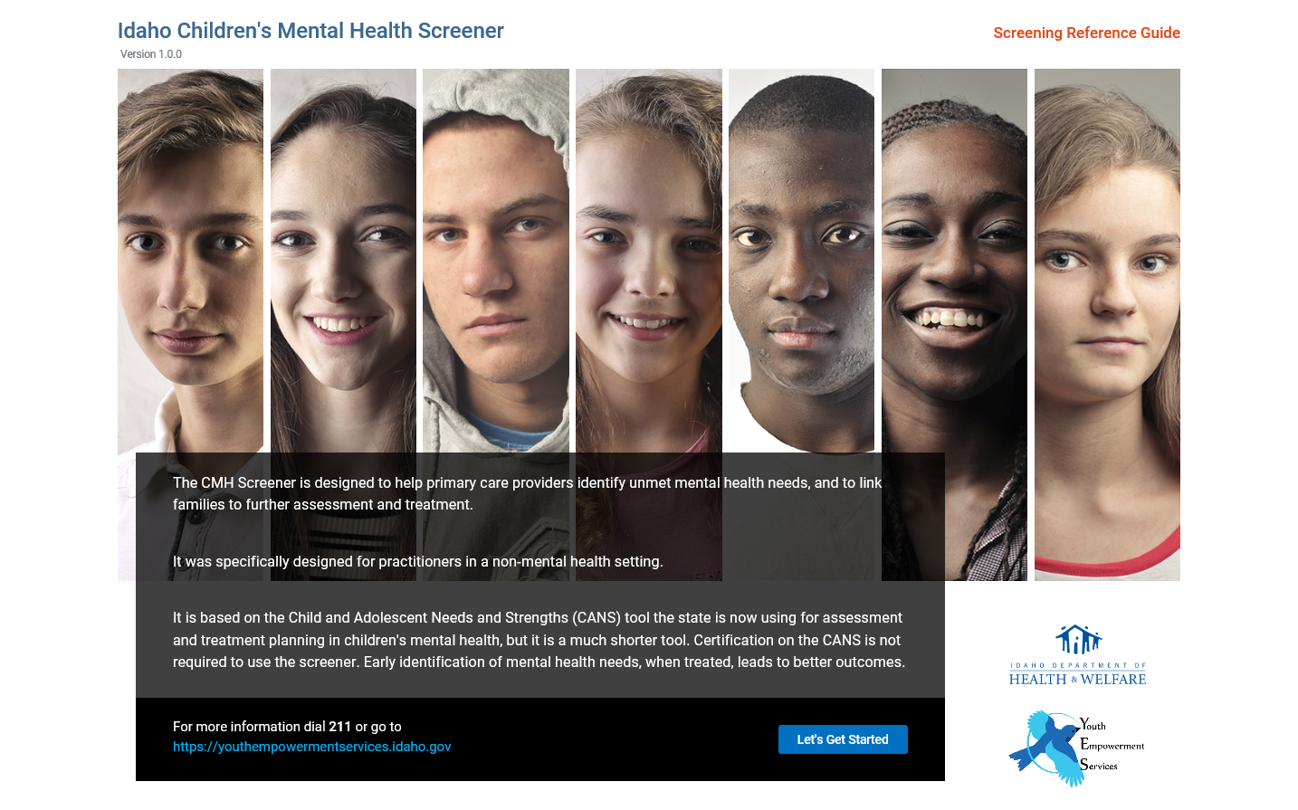
Using the Online CMH Screener
Access the Online CMH Screener from the website: www.IdahoCMHScreener.com and click “Let’s Get Started”

Slide 17
Using the Online CMH Screener
The Screener will navigate through a series of questions. These questions are the same items on the paper version.
Once you complete each question the Screener will automatically navigate you to the next question.
Once all questions are answered, click “Submit.”
Results will display based on your responses. The page will provide information and helpful resources to guide you on your next steps.
You can email or print the results.
No personal identifiable information (PII) is collected.

Slide 18
FOR MORE INFORMATION
Please visit youthempowermentservices.idaho.gov
for more information.

